Slide 1
Noise analysis of Spheroids
1/17/23
Daniel George
Bleris Lab

Slide 2
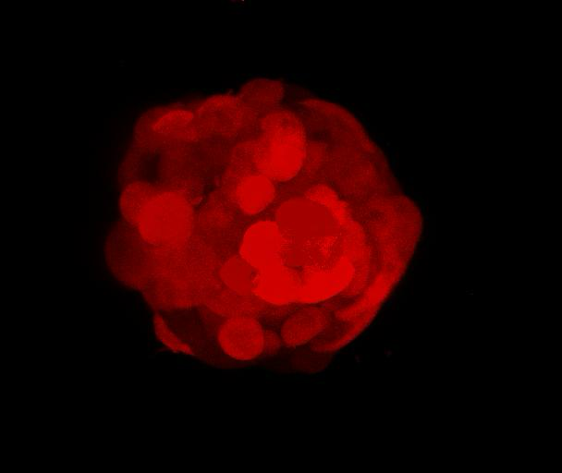
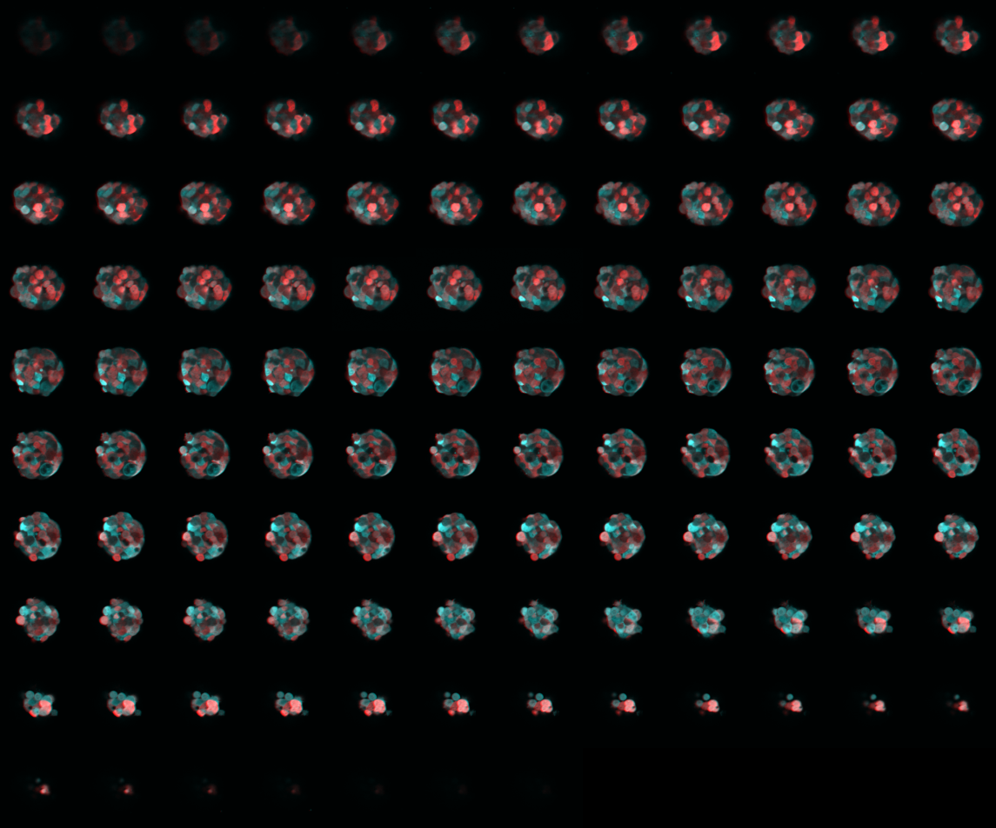
Spheroid data
Slices: 115
Analysis on 12-100
Fluorescence of cell line: CFP and mKate2
What was used: confocal microscopy

Slide 3
Goal / hypothesis
Decompose total noise into extrinsic and intrinsic noise in a segmented fluorescence image of the spheroid
Hypotheses:
- Extrinsic noise changes based on if slice is towards the top and bottom of spheroid vs in the middle of the spheroid
- Unsure about trends in intrinsic noise

Slide 4
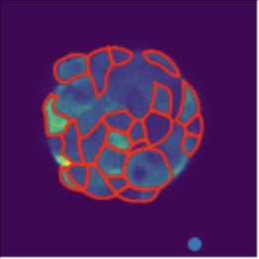
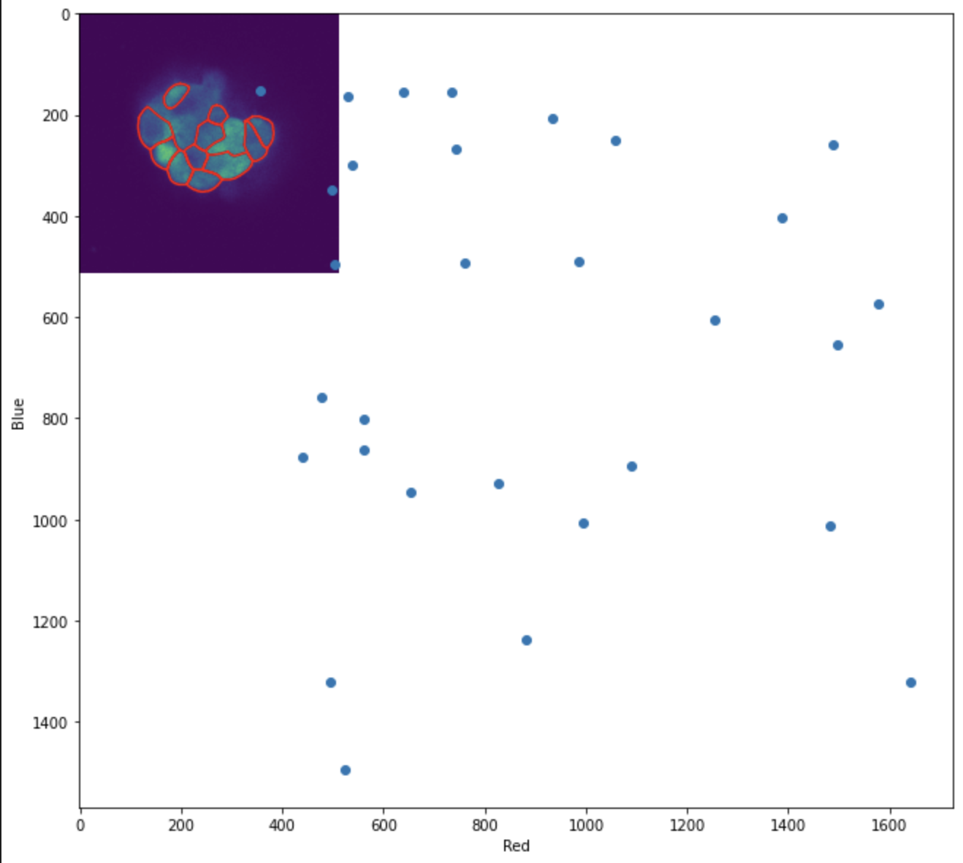
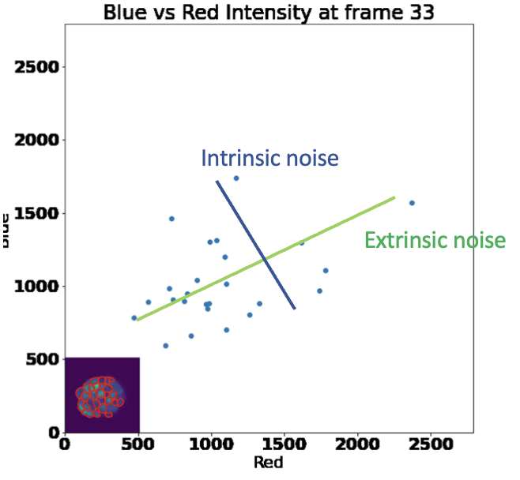
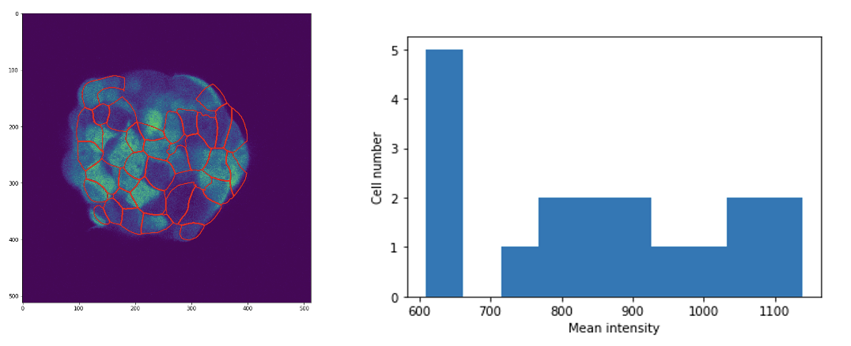
Process overview
1. Segmentation
2. Calculate mean for each segmented cell
3. Scatter plot for visualization
4. Intrinsic and extrinsic noise calculation

Slide 5
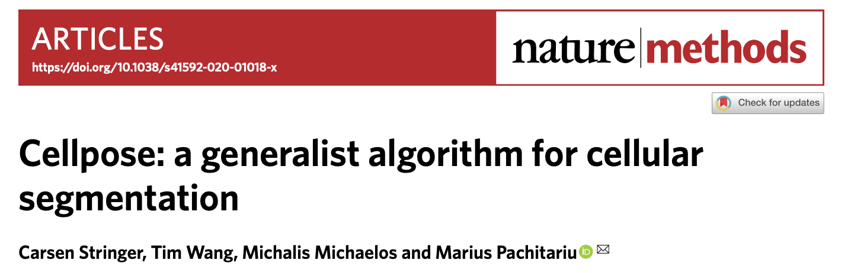
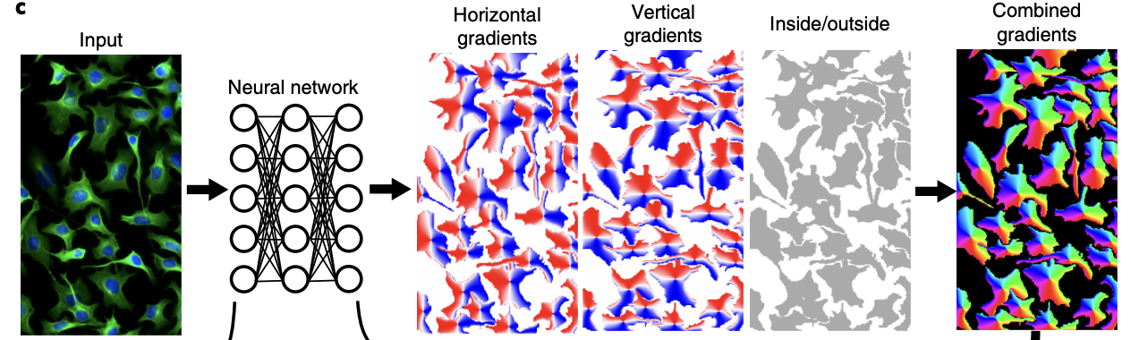
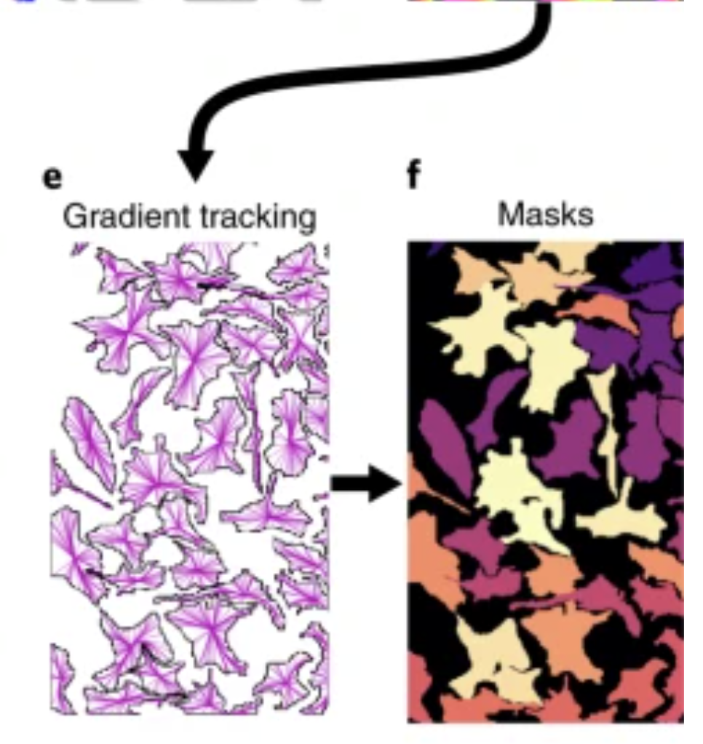
1. Segment
Cellpose algorithm (Stringer et al. Nature Methods 2021)
Outputs the boundaries of different cells
Notes:
Classical segmentation that was used involves the watershed algorithm which has to do with treating the image as a topological map and finding basins. Doesn’t work well with a lot of data because it is messy. This algorithm trained a modified U-net neural net to create an intermediary that is easier to segment. The intermediary is a vector flow representation of a simulated diffusion process. After they are combined, the gradient vector fields make a dynamical system where the pixels go to a fixed point. The pixels that all converge to a certain fixed point becomes a mask.
They also added an extra parameter to consider that different data types have different styles of segmentation.

Slide 6
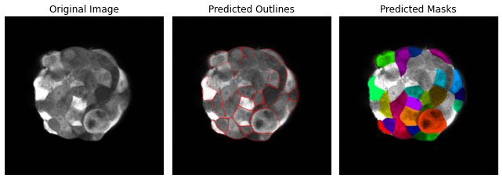
Segmentation example
Cellpose algorithm
Outputs the boundaries of different cells
Ex. frame 54

Slide 7
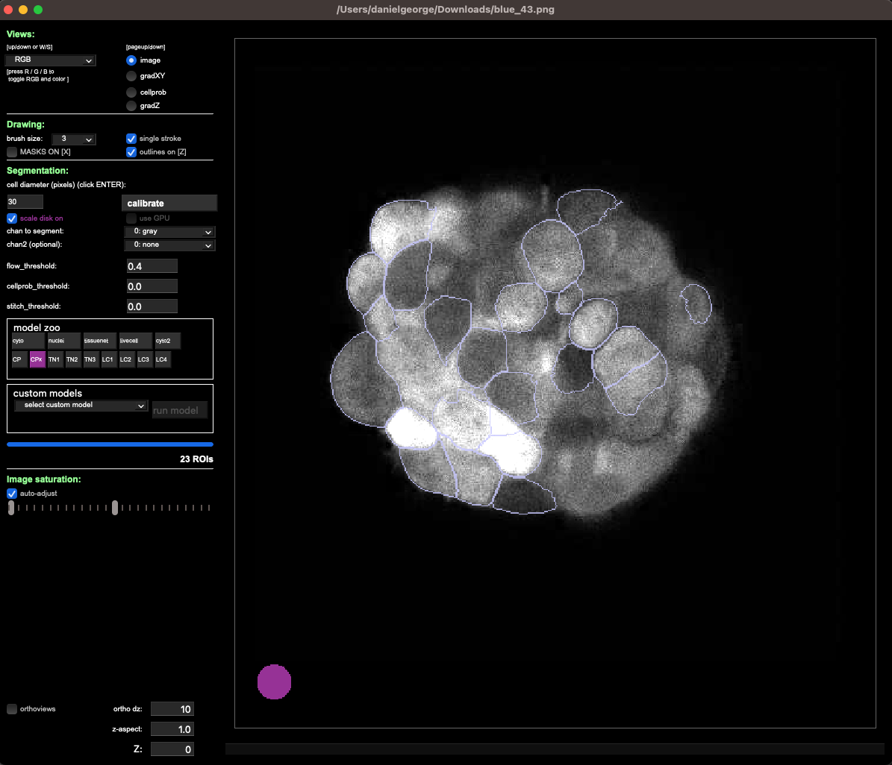
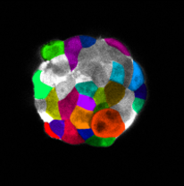
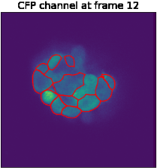
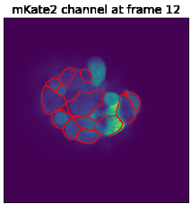
Current segmentation workflow
Use GUI to
Find average cell diameter
Pick best pretrained network
Choose channel to create segmentation
CFP has higher intensity on average which led to better segmentations than mKate2
Iterate through outlines of different cells and do statistical analysis on intensities

Slide 8
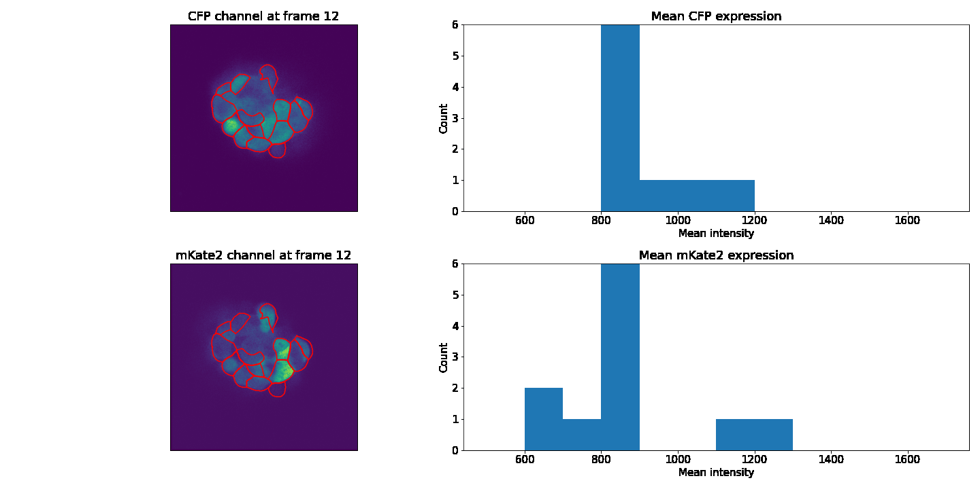
2. Mean intensity histogram
Notes:
Higher CFP expression made it a better choice for being the one used to create the segmentation masks.

Slide 9
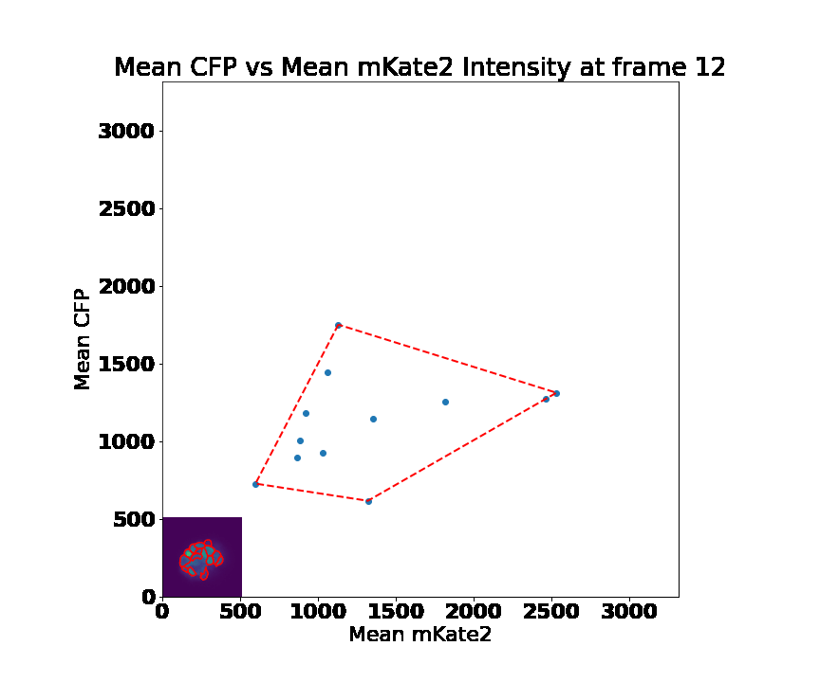
3. Scatter plot for visualization
Notes:
If there are below a certain amount of cells, should I remove that frame as an outlier? Happens towards the beginning or end where a frame has 6 cells compared to the center which has about 30.

Slide 10
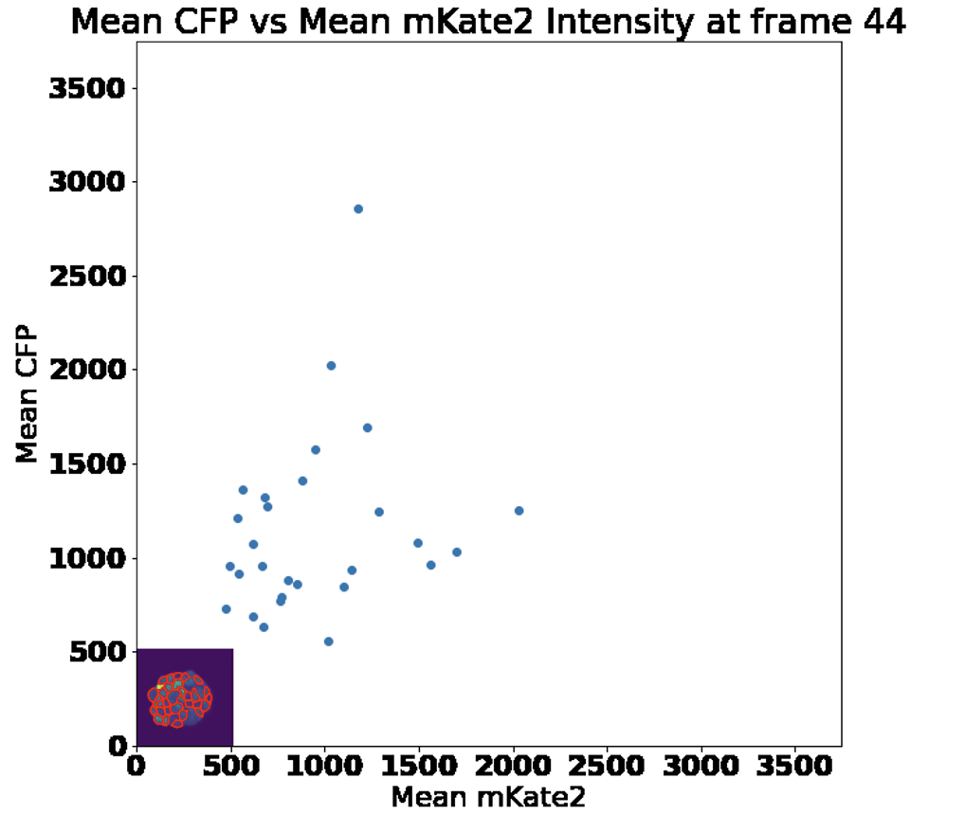
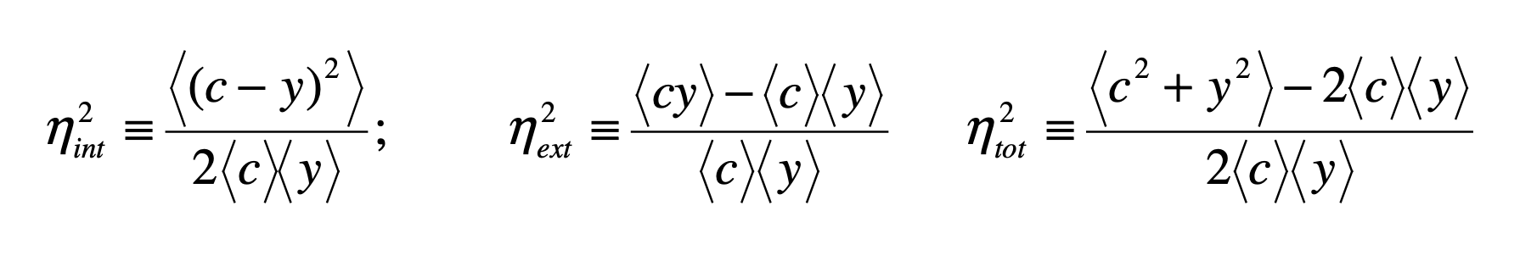
4. Noise decomposition
Intrinsic noise
Extrinsic noise
Swain PS, Elowitz MB, Siggia ED. Intrinsic and extrinsic contributions to stochasticity in gene expression. Proc Natl Acad Sci USA. 2002
Notes:
Use formula from https://authors.library.caltech.edu/74808/3/%5BStatistical%20Applications%20in%20Genetics%20and%20Molecular%20Biology%5D%20Estimating%20intrinsic%20and%20extrinsic%20noise%20from%20single-cell%20gene%20expression%20measurements.pdf; same as the one from Elowitz on the slides.
Elowitz: https://pubmed.ncbi.nlm.nih.gov/12237400/

Slide 11
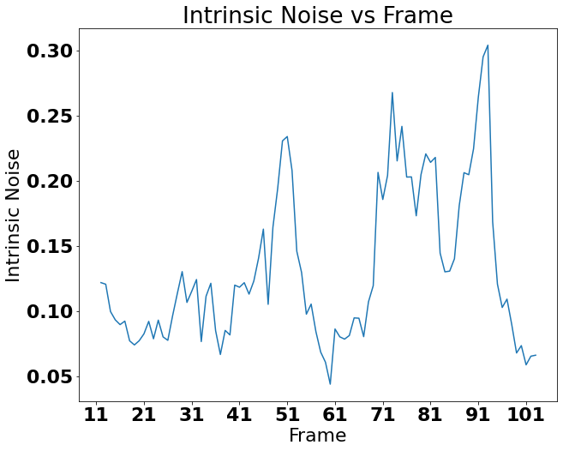
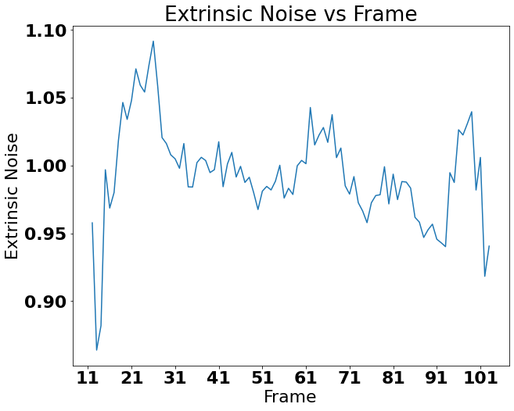
Intrinsic and extrinsic noise calculation
Notes:
The ends of the extrinsic noise being high could be because the segmentation is circling ones that are all black as well as the middle one with high expression. The overall trend doesn’t seem to have changed with fixing the offset.

Slide 12
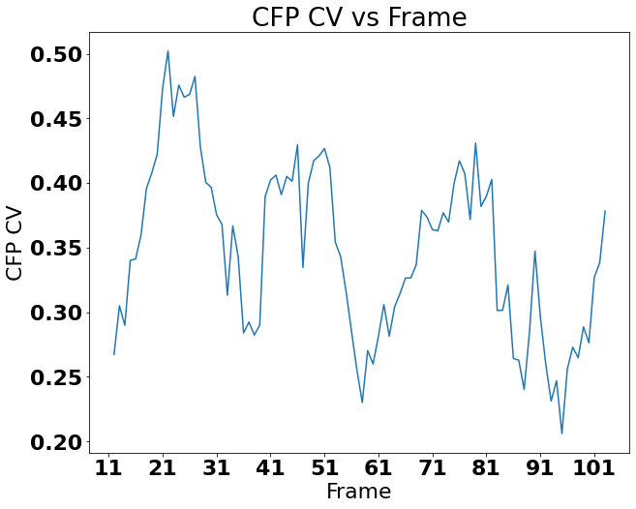
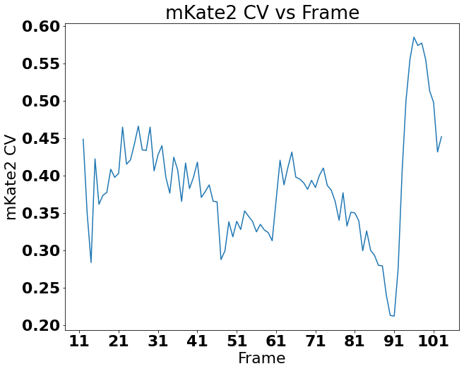
CV of expression vs Frame

